Slide 1
GENERAL BIOLOGY 1
BIO 101 / Department of Pure & Applied Botany
Dr A. S. Oyelakin

Slide 2
Course overview
Flowers
Fruits
Seeds

Slide 3
The Fruits
Fruits are fertilized and matured ovaries after fertilization. The fruits developed from fertilized ovaries while the ovules in the ovaries become the seeds.
In some plants, fruits are formed without fertilization, such fruits are known as parthenocarpic fruits and are usually seedless e.g. Banana and Pineapple
Parts of Fruits
Pericarp:
It is made up of three layers, an outer layer called epicarp, a middle layer called mesocarp and an inner layer called endocarp.

Slide 4
Types of Fruits
(1) Fruits are classified based on the floral parts that formed the fruit.
True fruits: e.g. Tomato (Solanum lycopersicum ).
False fruits: e.g. Cashew (Anarcadium occidentales).
Classification of True fruits
(2) Fruits are also classified on the basis of the number of flowers involved in the fruits formation.

Slide 5
(a) Simple fruits: They are formed from a single flower with a monocarpous pistil e.g. Cowpea
(b) Aggregate fruits: They are formed from a single flower with an apocarpous (separate) pistil e.g. Strawberry
(c) Compound/multiple fruits: They are formed from whole inflorescence e.g. Pineapple.

Slide 6
Types of simple fruits
Simple fruits are broadly divided into two classes on the basis of the nature of the pericarp namely;
(i) Fleshy/succulent: They have fleshy fruit walls and usually juicy. e.g. Tomato, Mango etc.
(ii) Dry fruits: They have hard, dry, fibrous or woody fruit wall. e.g. Beans.
Types of fleshy fruits
(1) Drupe: This is a true, simple fruit with well-developed pericarp e.g. Mango.
(2) Berry: This is a true, simple fruit with well-developed pericarp but the endocarp is fleshy and it is usually many-seeded e.g. Tomato.

Slide 7
(3) Hesperidium: It is a true simple fruit with distinct chambers that are separated by sheets of endocarp. e.g. Orange.
(4) Pome: It is a simple false fruit that develops from an inferior ovary e.g. Apple.
(5) Sorosis: It is a fleshy, multiple false fruit formed from a closely packed inflorescence. e.g. Pineapple.
(6) Syconus: This is a fleshy multiple false fruit formed from a closely packed inflorescence. e.g. Fig.

Slide 8
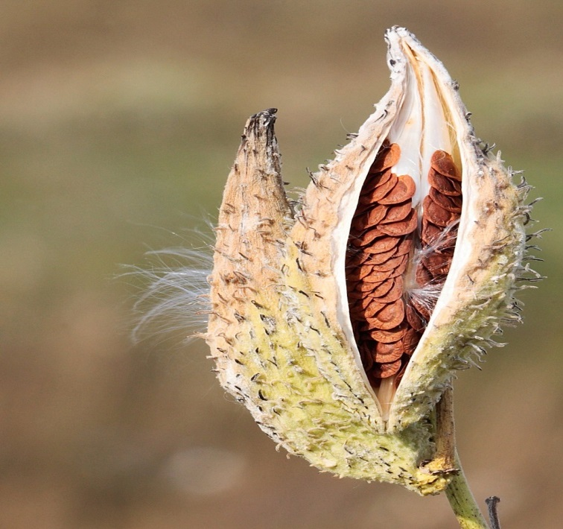
Types of dry fruits
Dry Dehiscent fruits: Those whose pericarp splits open to release their seeds.
(1) Follicle: This is a simple dry fruit formed from a superior monocarpous pistil and splits longitudinally along one suture only e.g. milkweed.

Slide 9
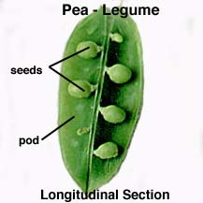
(2) Legume: This is a simple dry fruit formed from a superior monocarpous pistil. It is usually long and flat with two sutures to release the seeds inside e.g. Delonix regia.

Slide 10
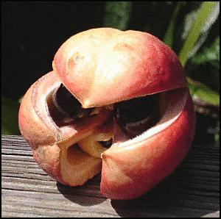
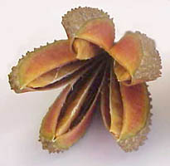
(3) Capsule: This is a simple dry fruit formed from a superior syncarpous pistil and splits at more than two sutures e.g. Okro and Cotton.

Slide 11
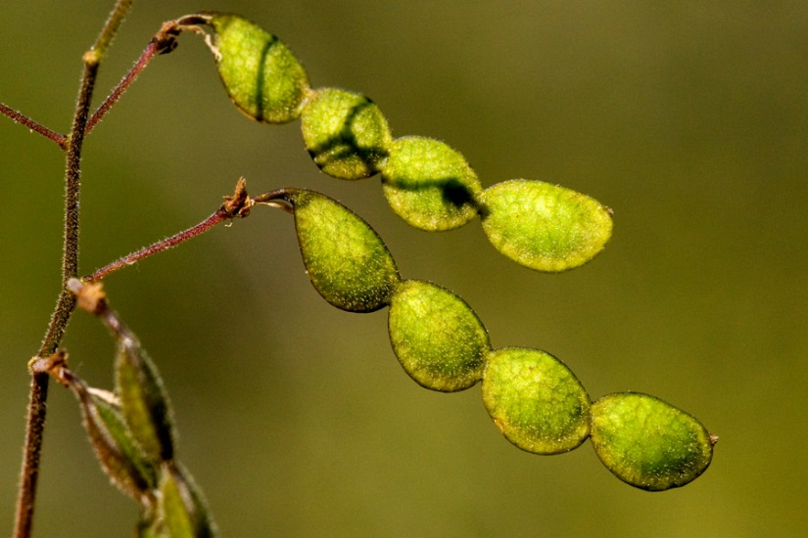
(4) Schizocarp is a many-seeded simple dry dehiscent fruit formed from a superior ovary which breaks up into a number of small one-seeded parts when ripe e.g. Castor oil & Desmodium.

Slide 12
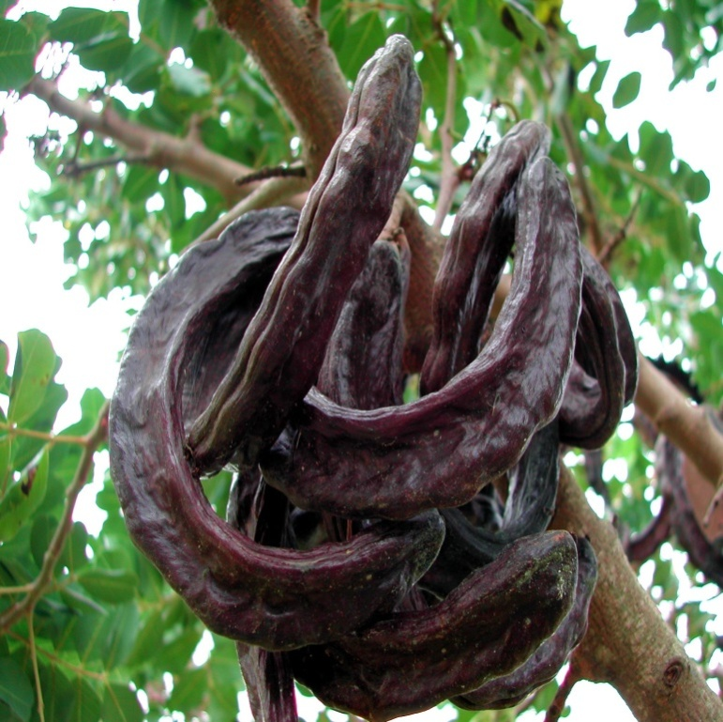
(5) Siliqua: This is a long, narrow, two-chambered capsule-like fruit formed from a bicarpellary ovary. The two chambers are separated by a false calyx and the fruit splits at the two sutures e.g. Tecomastan.

Slide 13
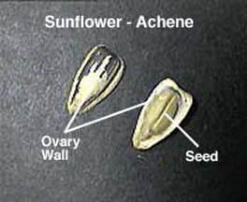
Dry Indehiscent Fruits: Those fruits whose pericarps do not split open to release their seeds. They are usually small size, but are produced in large number.
(1) Achene: This is a small, one-chambered and one-seeded fruit formed from a monocarpous pistil. . e.g. Sunflower, Aspilia sp., Tithonia diversifolia

Slide 14
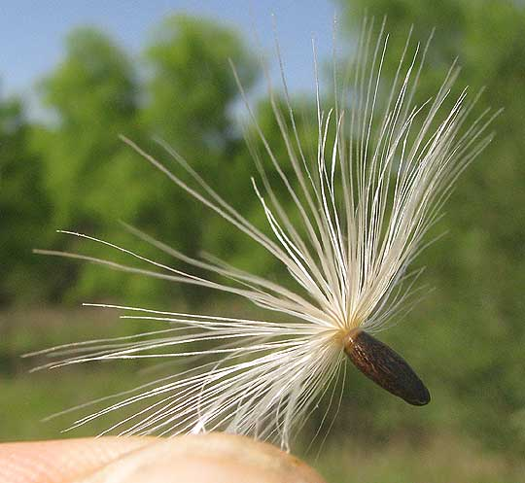
(2) Cypsela: This is formed from bicarpellary ovary and bears persistent calyx as tuft of hairs (pappus) e.g. Tridax procumbens.

Slide 15
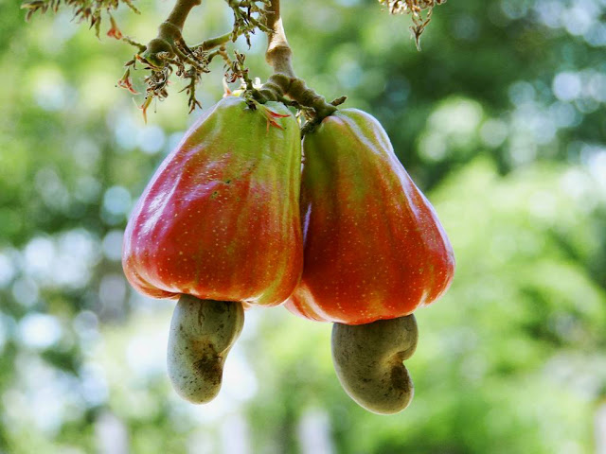
(3) Nut: This is a fruit with tough, stony or woody pericarp e.g. Cashew nut and Walnut, etc.

Slide 16
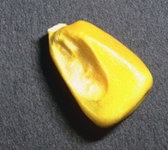
(4) Caryopsis: This is a small one-seeded fruit whose the pericarp and seed coat fuse to form a thin cover over the seed e.g. Maize

Slide 17
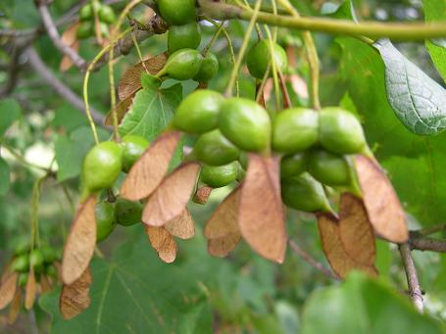
(5) Samara: This is one or two-seeded achene-like fruit with the pericarp extended to form wings e.g. Combretum, Dipterocarpus etc.

